Slide 1
Experiences in CAT B Cartography Course
IHO – NIPPON FOUNDATION
ALUMNI SEMINAR
Lt. Cdr. REBECA COPÉ DE LOS MOZOS

Slide 2
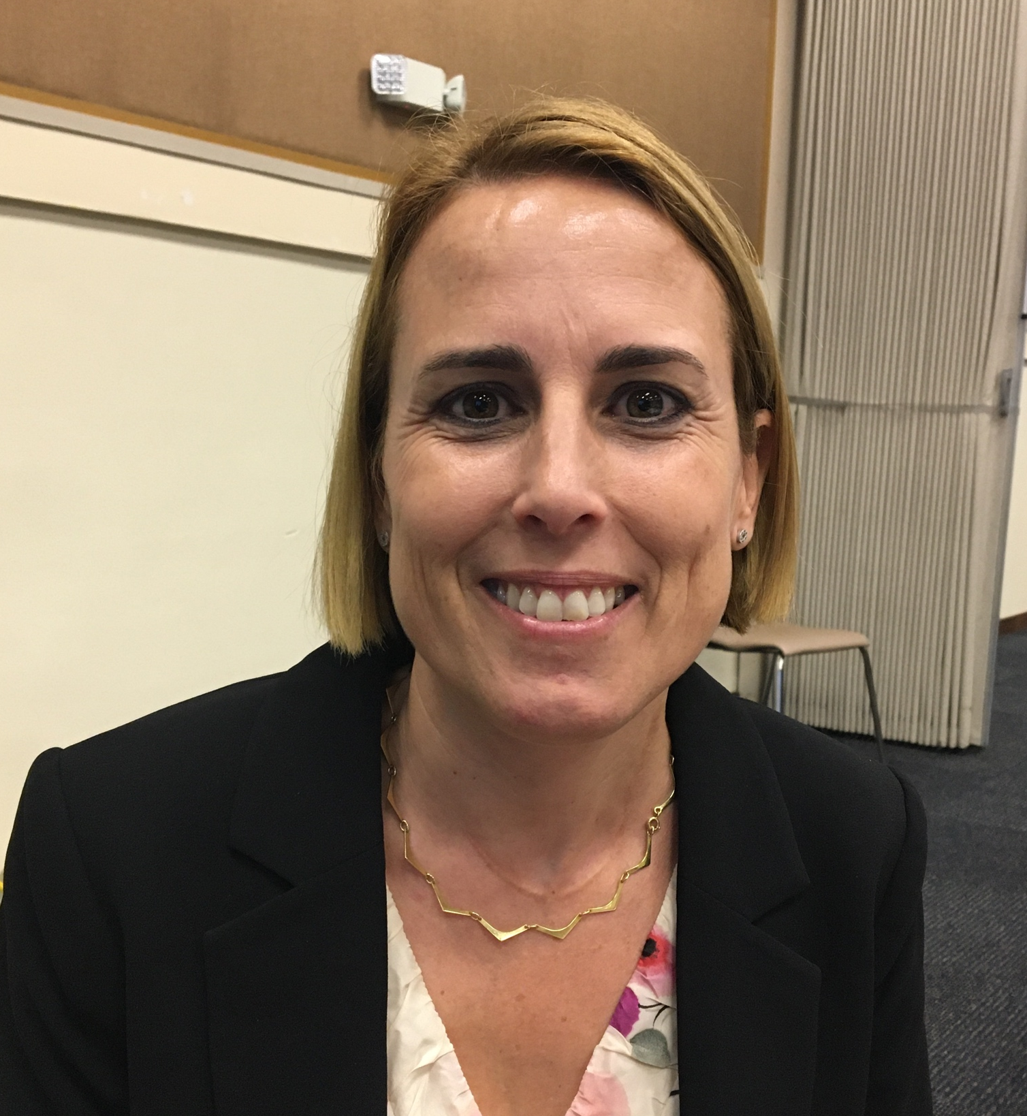
Self introduction
IHO – NIPPON FOUNDATION
ALUMNI SEMINAR
Name | REBECA COPÉ DE LOS MOZOS
Alumni year | 2014 (6th Course)
Country | SPAIN
Organization | INSTITUTO HIDROGRÁFICO DE LA MARINA
Position/Job title | LIEUTENANT COMMANDER/HEAD OF PAPER CHART PRODUCTION AND PHOTOGRAMMETRY DEPARTMENT
Current job description | To decide and coordinate the paper chart production in CARIS HPD (Source and paper chart editor) and the old software (Microstation)
Please put your photo here!

Slide 3
My career path and projects / Achievements
IHO – NIPPON FOUNDATION
ALUMNI SEMINAR
Hydrographer (2004-2005), Certificate CAT A (2007).
4 years in Hydrographic vessel.
6 years in Spanish Hydrographic Office (Instituto Hidrográfico de la Marina).
Hydrographic Engineer. Master in GIS and “Hydrographic Data Processing and Marine Cartography” in Taunton (2014).
Certificate CAT B since 2016.
Same post since 2015.
Attended several meetings (ENCWG, IC-ENC TC).
Surveys in Antarctica.
Training of new personnel.

Slide 4
My career path and projects / Achievements
IHO – NIPPON FOUNDATION
ALUMNI SEMINAR
360 paper charts, 42 in CARIS HPD. Long time to migrate from old software.
Plan in order a geographic area but what finally makes the order is the updating need and new surveys.
Keep on working on the shift.

Slide 5
Lessons learned from CHART Course
IHO – NIPPON FOUNDATION
ALUMNI SEMINAR
Think as a cartographer and not as hydrographer.
Know what I can ask to the compilers.
Being able to take proper decisions in the compiling process.
I have colleagues that can help me to solve any doubt.

Slide 6
Suggestion for the future
IHO – NIPPON FOUNDATION
ALUMNI SEMINAR
Keep on with the CAT B Course in Cartography.
CAT A Course in Cartography.
Continue giving us the chance to meet again.

Slide 7
